Slide 1
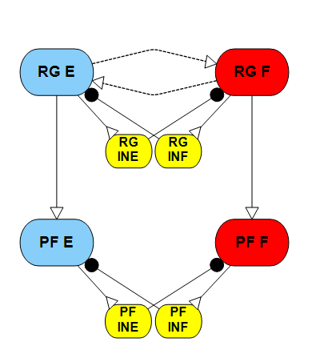
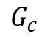
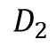
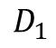
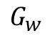
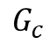
Analysis of the two-layer CPG
$$D_{1}$$
The reason we analyze the two-layer CPG is to quantify how different signal inputs will change the performance of output results.
There is study about the phase-plane and frequency control of the half- center CPG (Daun et. al 2016; Ausborn et. al 2017), also Spardy did a dynamical systems analysis of the rhythm generator.
But none of these studies can meet our demand.
$$G_{w}$$
$$G_{c}$$
$$G_{c}$$
$$D_{2}$$

Slide 2
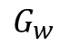
Analysis of the rhythm generator
In our last couple meetings we showed how signal and conductance control the oscillation period of the rhythm generator. But the surf plot did not show much information.
$$G_{w}$$
Frequency (Hz)
Stimulus drive (nA)

Slide 3
Analysis of the rhythm generator
Frequency (Hz)
Stimulus drive (nA)

Slide 4
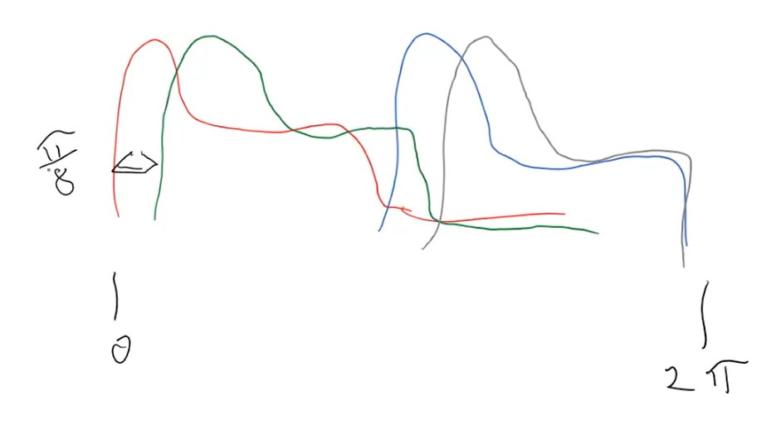
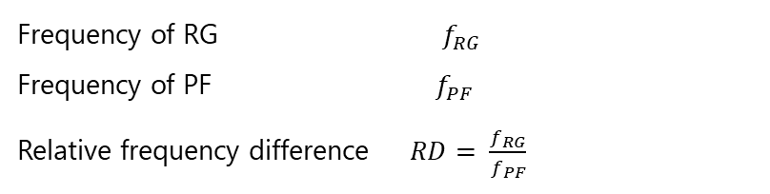
Analysis of the phase delay
When the pattern formation and rhythm generator frequency equals (or close), but the timing is not.
$$f=1.6813 hz$$
6.25%
10.3%
$$f=1.6813 hz$$
Frequency of RG $f_{RG}$
Frequency of PF $f_{PF}$
Relative frequency difference $RD= \frac{f_{RG}}{f_{PF}}$
When the $RD <5\%$ we consider it’s frequency equal.
When frequency equal, we count every cycle start of RG and PF then take the mean of it’s difference as mean phase shift, then divide it by RG frequency we get the phase delay percentage.

Slide 5
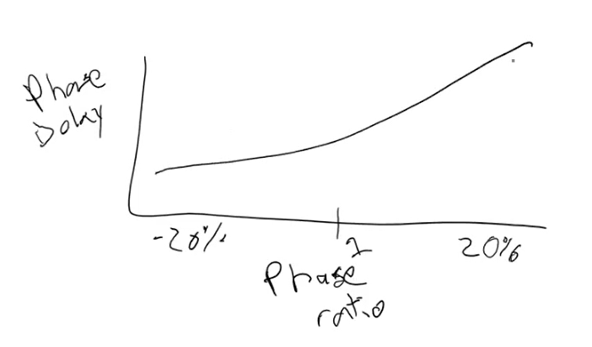
Analysis of the phase delay
The phase delay let us design the CPG output stick to the rhythm but have certain freedom to meet our demand, ideally we want to get a relationship similar to picture below. However, for different situations the plot varies.

Slide 6
Situation 1:
When we determined an oscillation frequency ($f_{RG}$ is constant) how strong connections between RG and PF (C>0.1) and signal into the PF influence the phase delay. [ D1 = 3; Gw = 0.1]
Relative frequency difference
Phase shift
Conductance (uS)
Stimulus drive (nA)
Stimulus drive (nA)
When the connection between RG and PF gets stronger, the phase delay disappear.

Slide 7
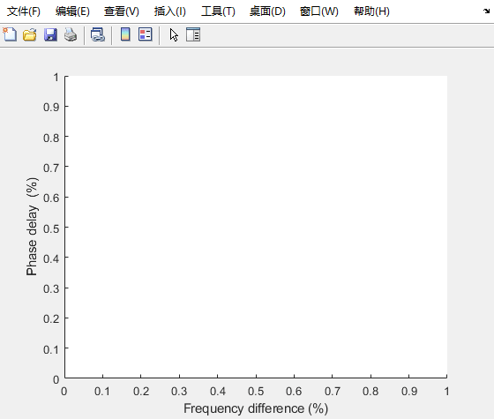
Situation 1:
Phase delay Vs Phase Ratio
Animate
Final result
Larger C value shrink the phase delay range.

Slide 8
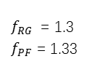
Situation 2:
When we determined an oscillation frequency ($f_{RG}$ is constant) how weak connections between RG and PF (C<0.2) and signal into the PF influence the phase delay. [ D1 = 3; Gw = 0.1]
Relative frequency difference
Phase shift
Conductance (uS)
PD = 2.64%
PS = 19.85%
$f_{RG}$ = 1.3
$f_{PF}$ = 1.33
Descending drive (nA)
Descending drive (nA)
When the connection between RG and PF is weak, high inputs to PF will disrupt the rhythm of it.

Slide 9

Situation 2:
Phase delay Vs Phase Ratio
Animate
Final result
Larger C value shrink the phase delay range.

Slide 10
Situation 3:
When we determined an output frequency ($f_{PF}$ is constant) how strong connections between RG and PF (C>0.1) and signal into the RG influence the phase delay. [ D2 = 4; Gw = 0.1]
Relative frequency difference
Phase shift
Conductance (uS)
Stimulus drive (nA)
Stimulus drive (nA)
Strong connection always lock the phase, but when connection at appropriate range. Strong signal to the RG will increase the phase delay.

Slide 11

Situation 2:
Phase delay Vs Phase Ratio
Animate
Final result
Large C value bend the phase delay/frequency curve towards 0.

Slide 12
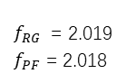
Situation 4:
When we determined an output frequency ($f_{PF}$ is constant) how weak connections between RG and PF (C<0.2) and signal into the RG influence the phase delay. [ D2 = 4; Gw = 0.1]
Relative frequency difference
Phase shift
Conductance (uS)
PD = 0.05%
PS = 15.14%
$f_{RG}$ = 2.019
$f_{PF}$ = 2.018
Stimulus drive (nA)
Stimulus drive (nA)
When the connection between RG and PF is weak, high inputs to RG will cause larger phase delay (opposite to situation 2).

Slide 13

Situation 4:
Phase delay Vs Phase Ratio
Animate
Final result
medium C value (around 0.1) have better convergence for this situation.

Slide 14
Situation 5:
When we have set connections between RG and PF, how signal into PF and RG will influence the phase delay.
C = 1
C = 0.1
C = 0.01
D1 (nA)
D2 (nA)

Slide 15
Situation 5:
C = 1
C = 0.1
C = 0.01

